Slide 1

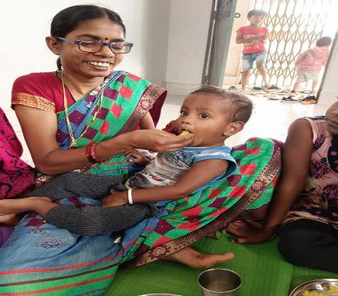
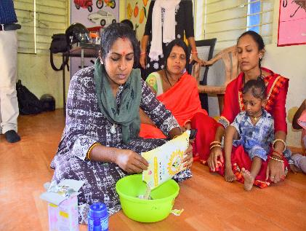
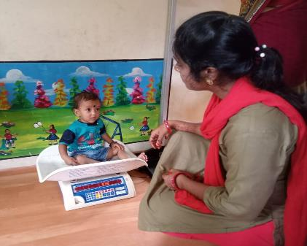
Social Revival Group of Urban Rural and Tribal
Introduction of A grassroot Organization
Serving More than 25 glorious years

Slide 2
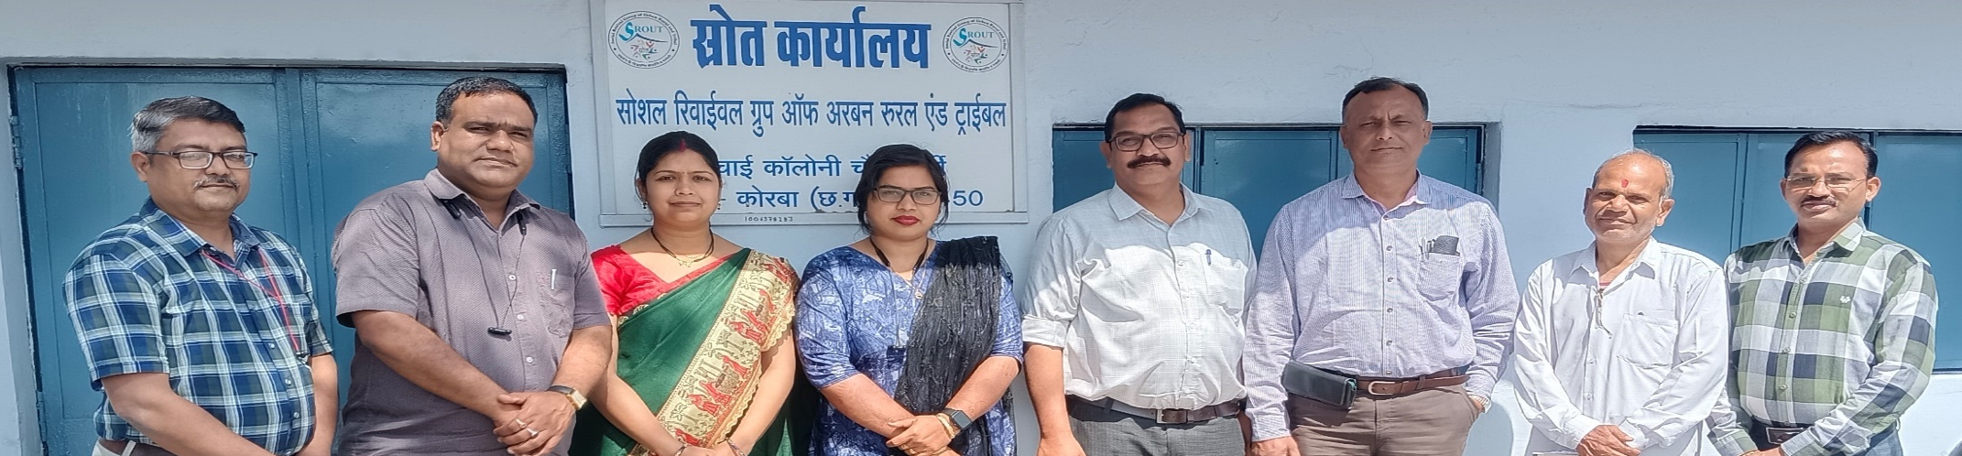
ABOUT SROUT
Registrations/Legal compliances
A society registered under M.P. Society Registration Act 1973.
Registration no – 2492, Date – 29.04.1999
Registered Address – H : 25 Irrigation colony, Darri, Dist – Korba (C.G.)
NITI Aayog - Unique ID – CG/2009/0015818.
Ministry of Corporate Affairs Registration number - CSR00001960
Income Tax 12 (A) : AAETS3216NE20142
80 G : AAETS3216NF20211
FCRA- 327610002 (31-12-2027)
PAN No - A A E T S 3 2 1 6 N
Email – sroutkorba@gmail.com, sroutkorba@rediffmail.com
Website- www.srout.org

Slide 3

ABOUT SROUT
Health and Nutrition
Child Rights and Protection
Livelihood
Women Empowerment and Protection
Soil and Water Conservation
Education
Sanitation and Environment
Focus Areas

Slide 4
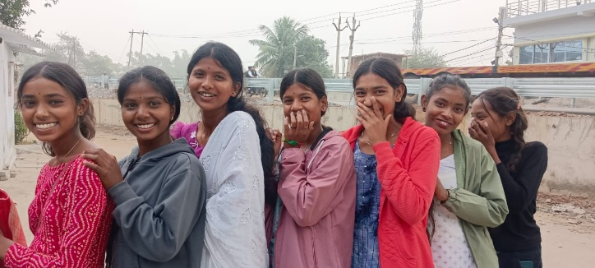
ABOUT SROUT
Initiation
Our Journey
Our journey commenced in 1999 in the Korba district, where we were entrusted with the mission of becoming the implementing agency for CARE India's Integrated Nutrition and Health Program. As we shared our vision of a brighter Korba with CARE India, it became evident that this vision needed a local champion to bring it to life. Thus, SROUT was born, and our commitment to the development of our local community was set in stone.
Learning
INHP
(Integrated Nutrition and Health program)
CARE
CHAYAN
(Targeted Intervention HIV/AIDS)
CARE
Targeted Intervention
(Targeted Intervention HIV/AIDS)
CG SACS
Pilot project MITANIN ASHA
Successful Replication
MAMTA
(Integrated Nutrition and Health program)
Balco CSr
JAGRITI
(HIV/AIDS Awareness)
Balco CSR

Slide 5
ABOUT SROUT
Major Projects
Watershed
(NABARD and Balco)
Anganwadi Workers Training center
(Women and Child development department)
Child Line
(Child Line India Foundation)
Trainings program Integrated child Protection schemes
(WCD)
Children Home
WCD Mission Vatsalya
Shakti Sadan
WCD Mission Shakti
Action research on Panchayat Extension to schedule areas act special focus on Water
(PRIA and arghyam )
Farmers Producers Organization
NABARD
DISHA
(Balco CSR)
Self Help Group Promotion
(SGSY, NRLM, NABARD, NULM)
Child Friendly Panchayat
(Unicef)

Slide 6
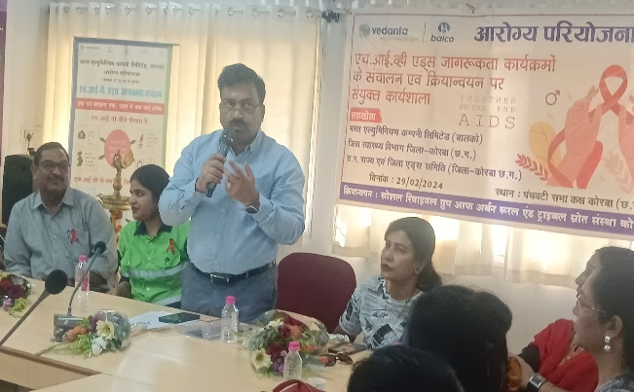
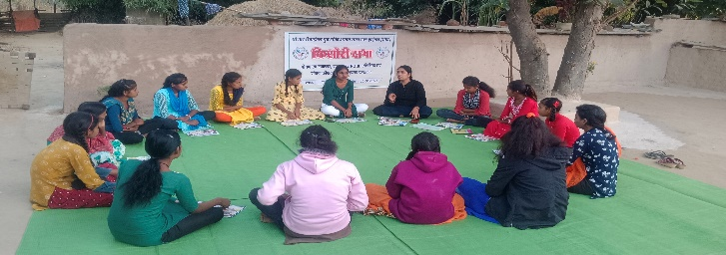
Education / Skill Development
Name of PROJECT | Funding Partner
Annaul Status of Education report (ASER) | PRATHAM
Skill Training under Vocational Training Program | District Urban Development Authority KORBA
Early Child development Department (ECD) | CARE INDIA
Anagan Wadi Worker Training centre | Women and Child development department CG
Training of Sanskaar Abhiyaan (ECCE) | WCD CG
Financial Literacy Program | NABARD and UNDP
Child protection and Child Rights
Name of PROJECT | Funding Partner
Training of Integrated Child Protection Scheme (ICPS) | State Women and Child Development department (C.G.)
Survey of Child in Need care and Protection under ICPS | State Women and Child Development department (C.G.)
Putting Children at the center – Stratigic Advocacy for Child Rights in India (Child Friendly Panchayat) | UNICEF
Child Line | Child Line India Foundation
SUCCESSFUL PROJECTS
HEALTH and NUTRITION
Name of PROJECT | Funding Partner
INHP II | CARE INDIA
CHAYAN PROJECT | CARE INDIA
TARGET INTERVENTION PROJECT | CG SACS
JAGRITI | BALCO CSR
MAMTA | BALCO CSR
Migrant Resource Centre | UNDP
CALL | The Leprosy Mission
MCSP capacity building of service providers on respectful care. | Center for Catalyzing Change (C3)
Drug De addiction Awareness program | NISD (National Institute of Social Defence)
Soil and Water conservation/ Environment/ Forest Rights/ PESA/Agriculture
Name of PROJECT | Funding Partner
ARI (Action Research Implementation) – PESA | PRIA
KISAAN club | NABARD
WATERSHED | NABARD
Farmers Producer organisation | NABARD

Slide 7
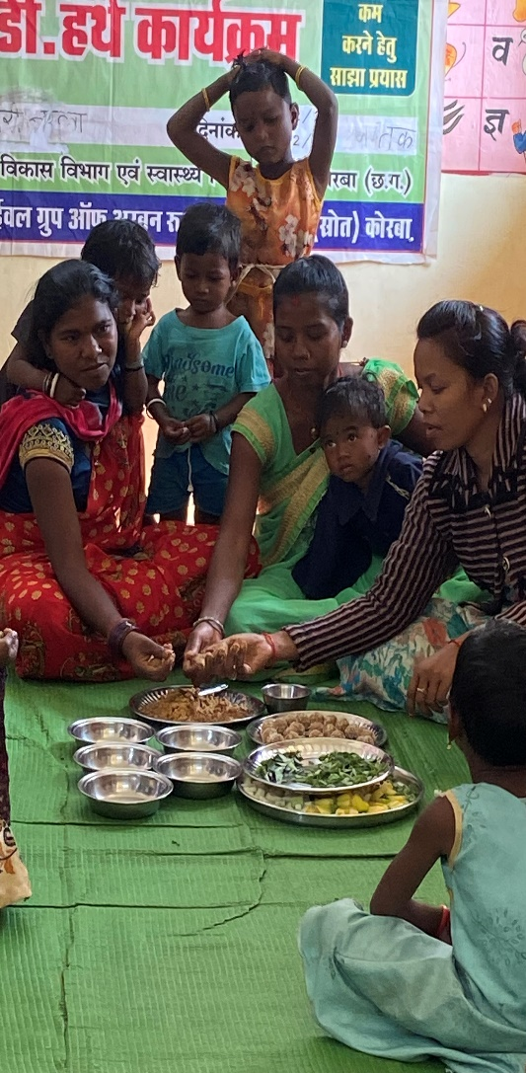
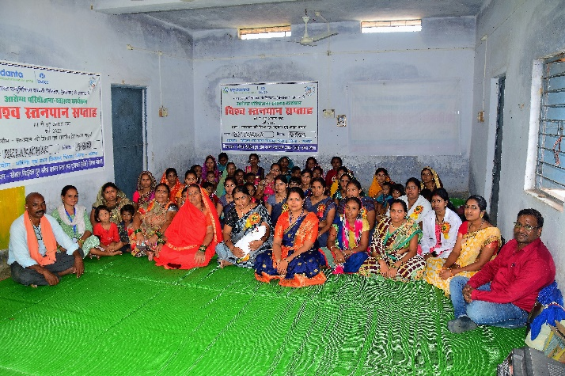
SUCCESSFUL PROJECTS
Othres Project
Name of PROJECT | Funding Partner
R and R Survey | IndiaBulls
R and R Survey | CSEB
R and R Survey | SENES
Chotia Coal Mines Village Support Program | Balco CSR
Audit of Toilet Made Under Swastya Vidhyalaya Abhiyaan | NTPC CSR
Youth Bol | C3 (Center for Catalyzing Change)
SDDN (Surakshit Dada Dadi Nana Nani Abhiyan) | Voluntary technical Support by Piramal Foundation
Flood Relief Work | Balco CSR
COVID Relief Work | Balco CSR District Administration KORBA
R and R Survey And report Preparation | Essel Mining Perivate Limited Aditya Birla Group
Livelihood and Women Empowerment
Name of PROJECT | Funding Partner
Formation of SHG | District Panchayat KORBA
SHPI (Self help Promotion Institution) | NABARD
SHPI (Self help Promotion Institution) | NABARD
Formation of SHG | Mucipal Corporation KORBA
DISHA | Balco CSR
Sevice Provider for Domestic Violence act | WCD
Unnati Project | Balco CSR

Slide 8
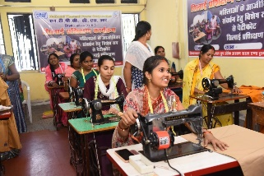
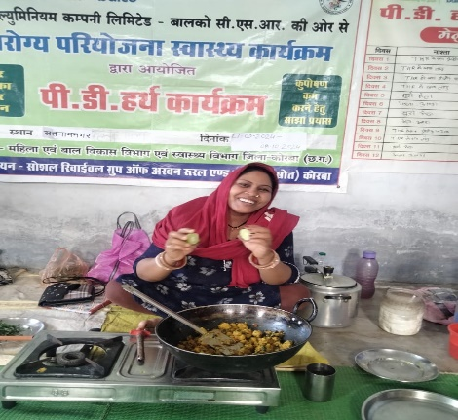
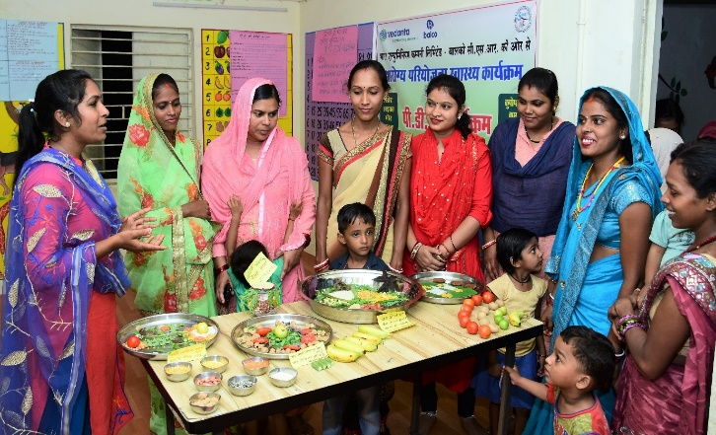
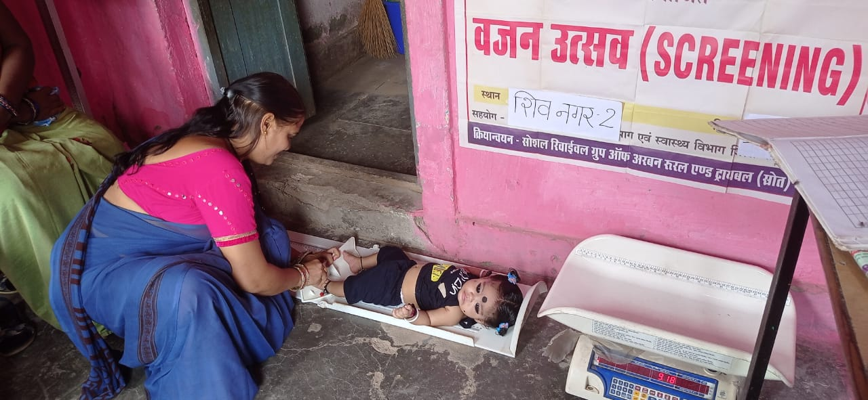
KEY ACHIEVEMENTS
Piloting MITANIN (ASHA) Program in District KORBA
More than 26 Years of Experience of Child Nutrition and Maternal Health Program
Pioneers of HIV/AIDS awareness program at Korba
Training and capacity Building of more than 5000 Anganwadi Workers through Anganwadi Workers Training Program
Shakti Sadan Home – 25 bedded – 250 women benefitted
Inter state Restored 16 cases
Child home – 50 bedded
200 children enrolled
More than 1000 Farmers Associated With FPO
Innovative Model PD Hearth
Formed and Nurtured More than 1000 SHG’s
Skill Development of more than 1000 women and 500 men

Slide 9







































PARTNERS

Slide 10
CURRENT PROJECTS
Rural Crèche
Balrampur District
AROGYA PROJECT
(CSR BALCO HEALTH)
CHILD HOME
(WCD)
WATERSHED (NABARD)
JJM
(PHED)
KORBA and Shakti District of CG
NANDGHAR
(BALCO VEDANTA CSR
KORBA, Raipur, Kawardha)
SHAKTI SADAN Under Mission SHAKTI (WCD)
FARMERS PRODUCERS' ORGANIZATION (FPO)
(NABARD)
Education
(ATHENA CSR)
Shakti (C.G.)
UNNATI
(BACLO CSR Livelihood)
Support Person JJ Act
(WCD, Shakti, Bilsapur, GPM, KORBA)
Enhancing Livelihood for Tribal Families ensuring quality goat rearing with support Technical of Goat Trust
TDH Nutrition and Biodiversity
Barra Community development project
(BACLO CSR)
Animal Welfare (BALCO CSR)

Slide 11
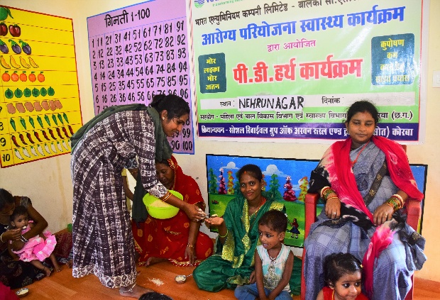
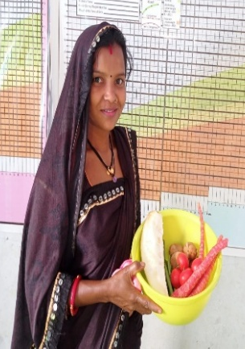
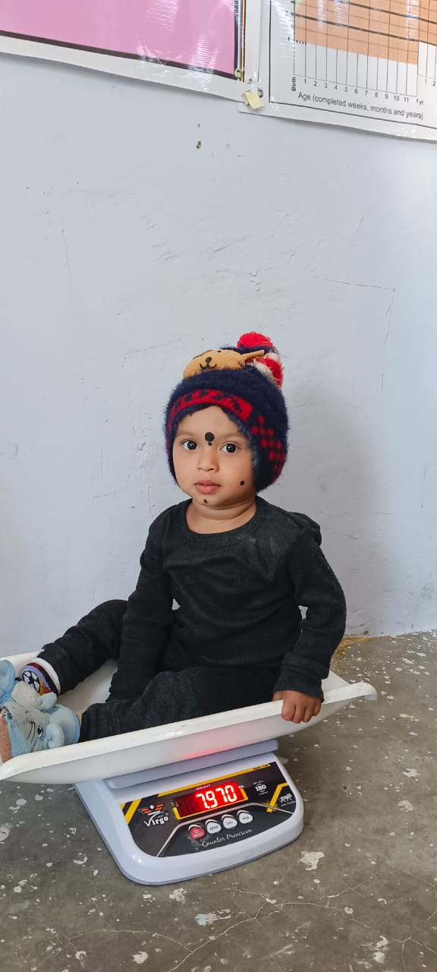
AROGYA PROJECT
(CSR BALCO HEALTH)
CURRENT PROJECTS
Maternal & Child Health
Malnourishment identification-Health Screenings (0-5yrs)
Making primary healthcare services accessible & affordable
HIV/AIDS
Target High Risk Groups- Truckers/ Migrants
Capacitating- Positive Deviance Hearth session
3 Rural Health Posts (RHPs)
HIV/AIDS Counselling center in RHP
Supplemental- THR trainings, Nutri-gardens.
Strengthening local health bodies
Group & Tele counselling, Canopy camps
TB
Nikshaya Mitra
Capacity Building for Early identification
Counselling support
Anaemia testing
Anaemia Session
Primary Healthcare

Slide 12
Nandghar
(CSR BALCO Education)
CURRENT PROJECTS
Education
Activities for Overall physical, mental, cognitive development
PD Hearth
Strengthening skill of worker
THR Training
Stockholders support group
Malnutrition

Slide 13
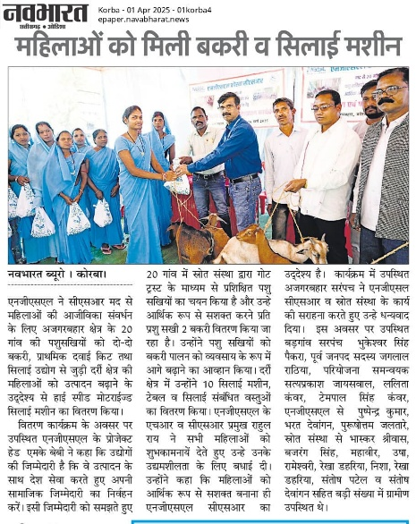
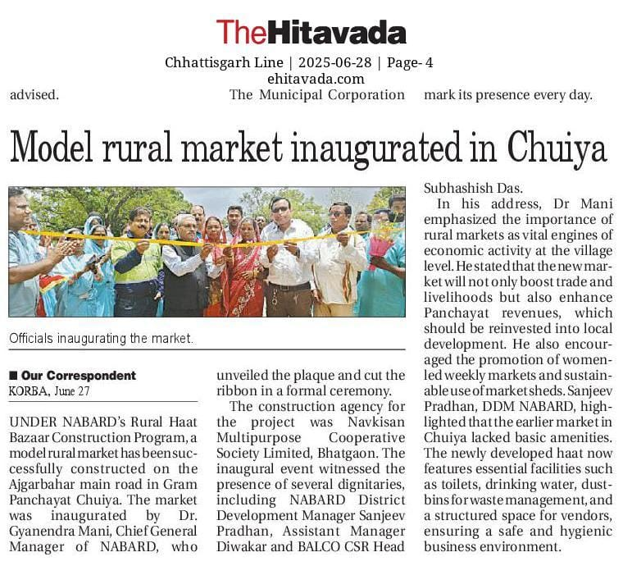
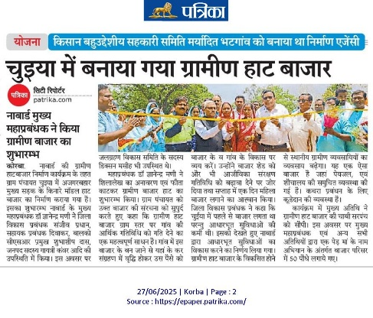
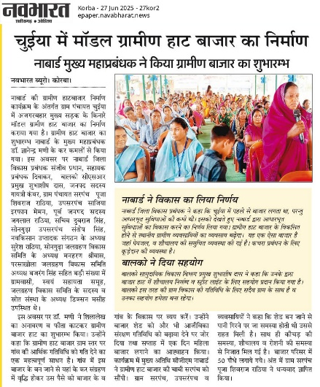
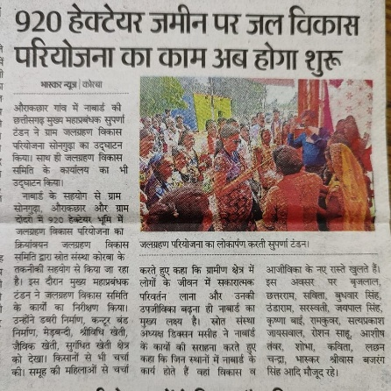
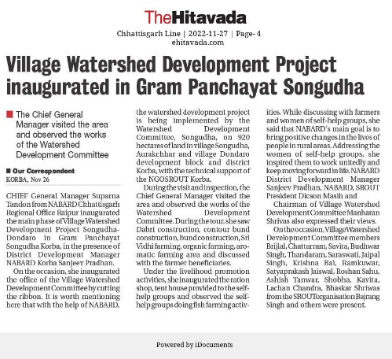
Media Clippings

Slide 14
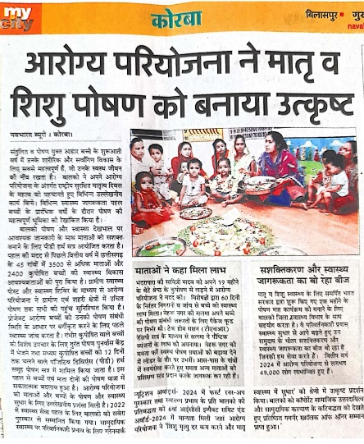
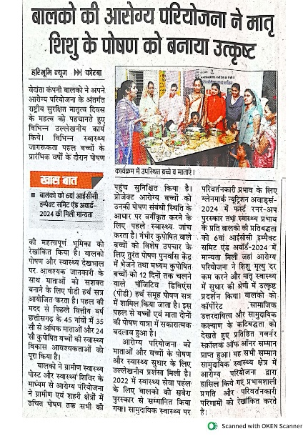
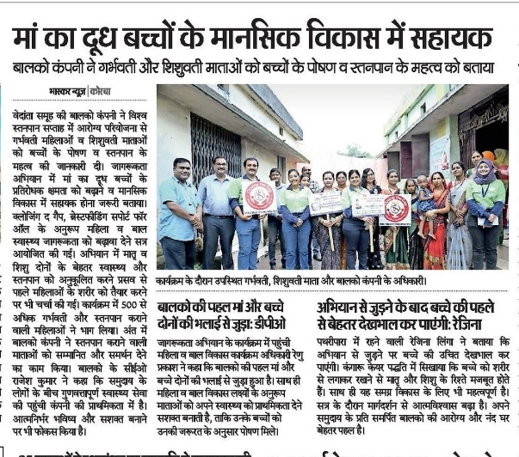
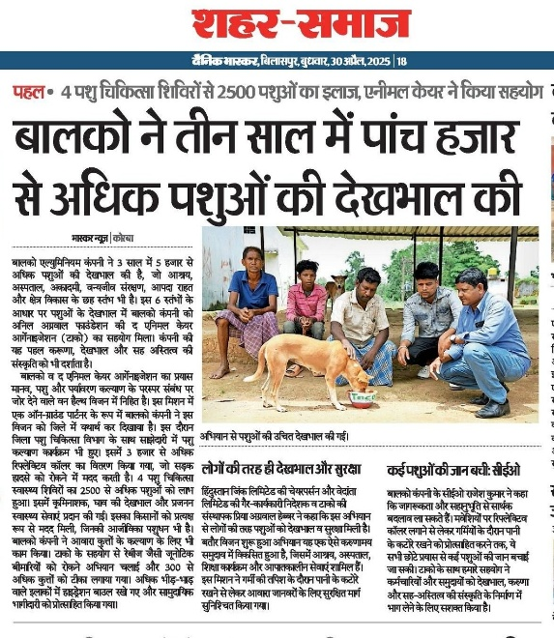
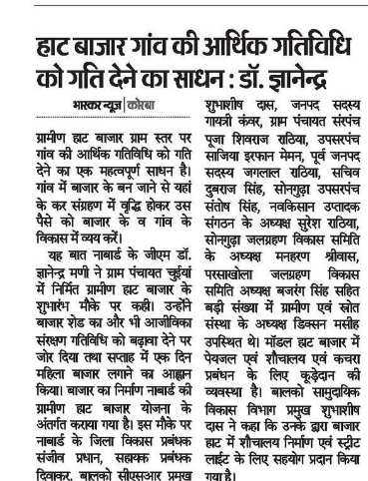
APPRECIATIONS

Slide 15
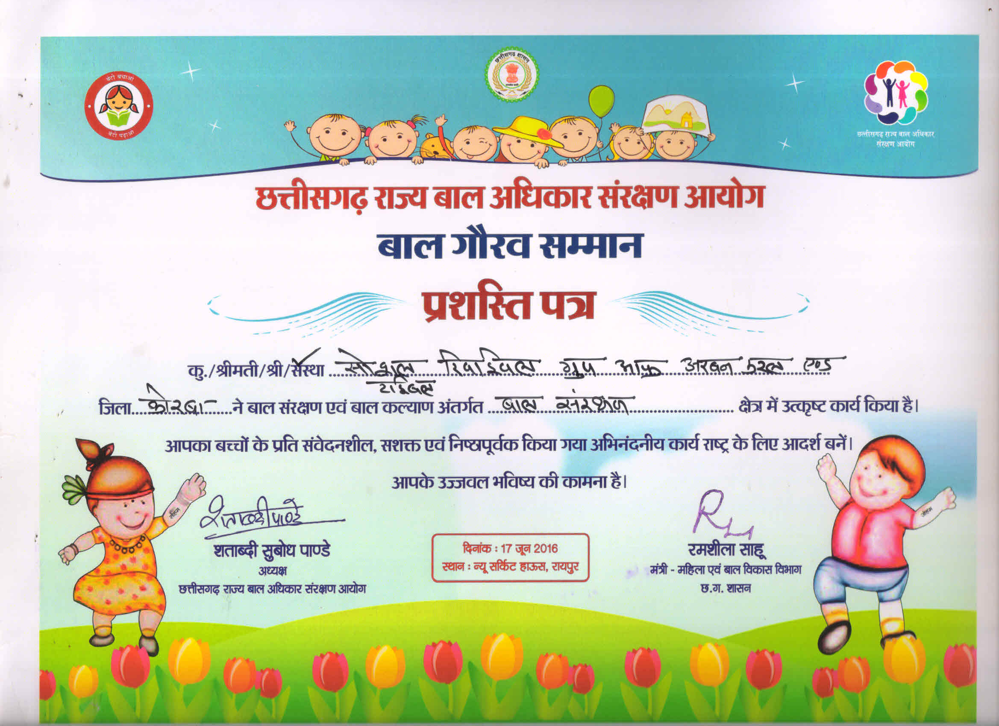
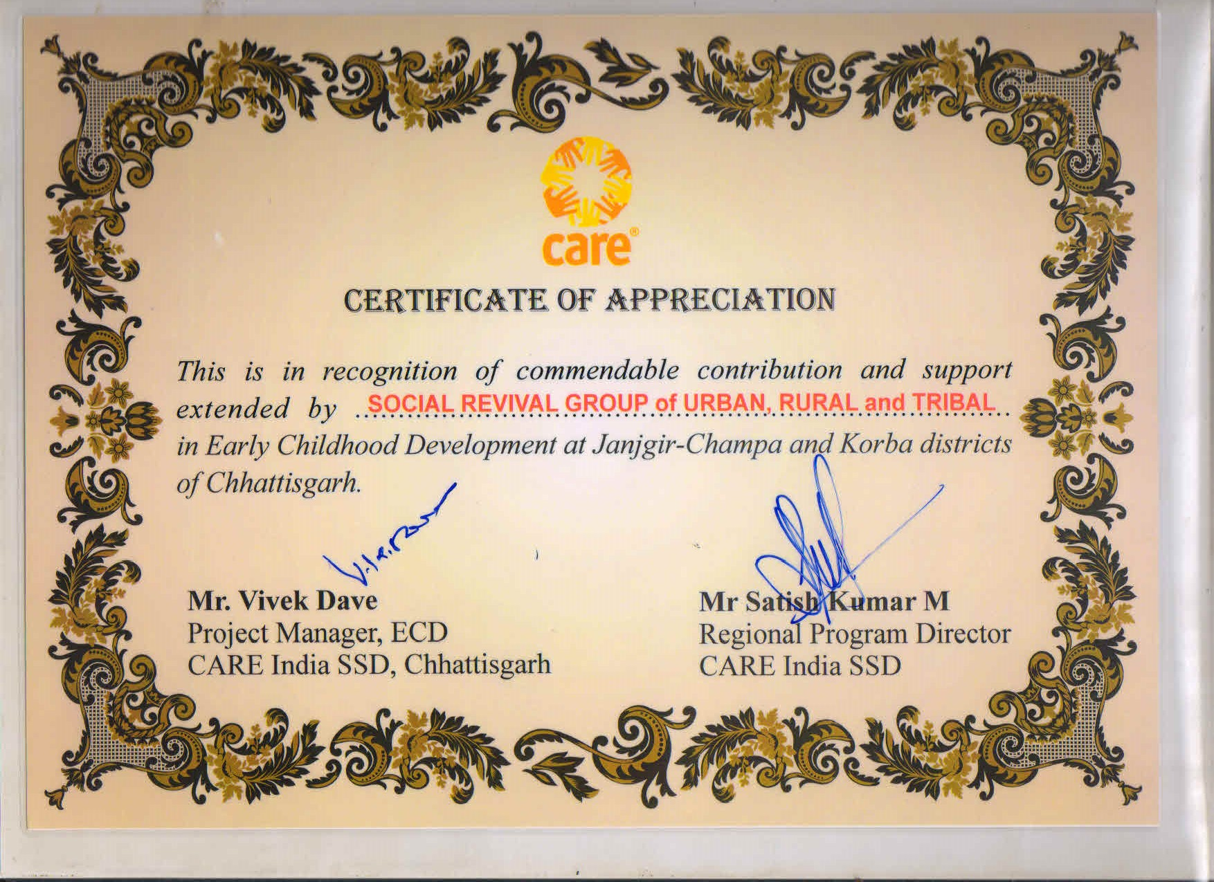
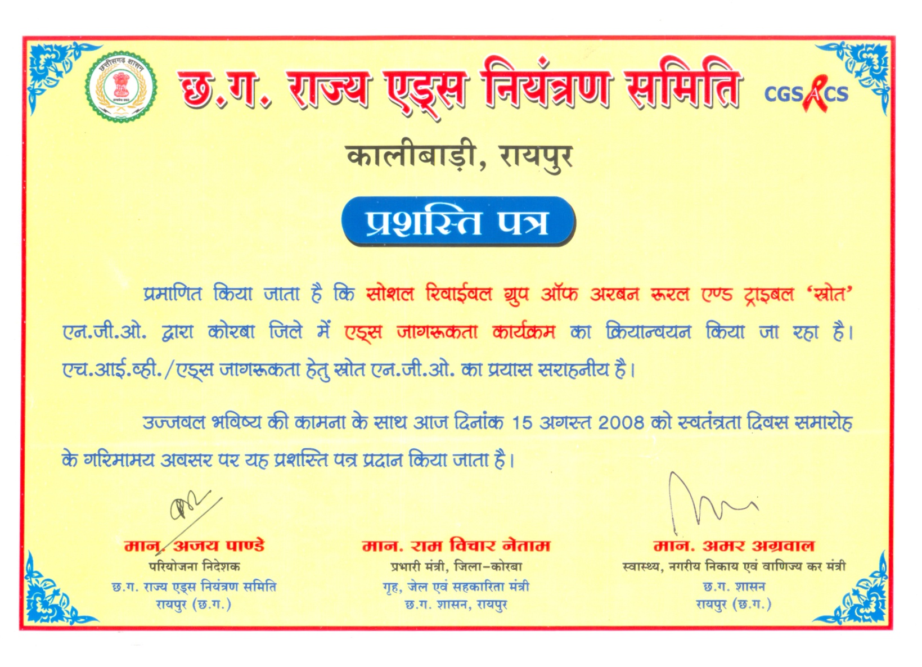
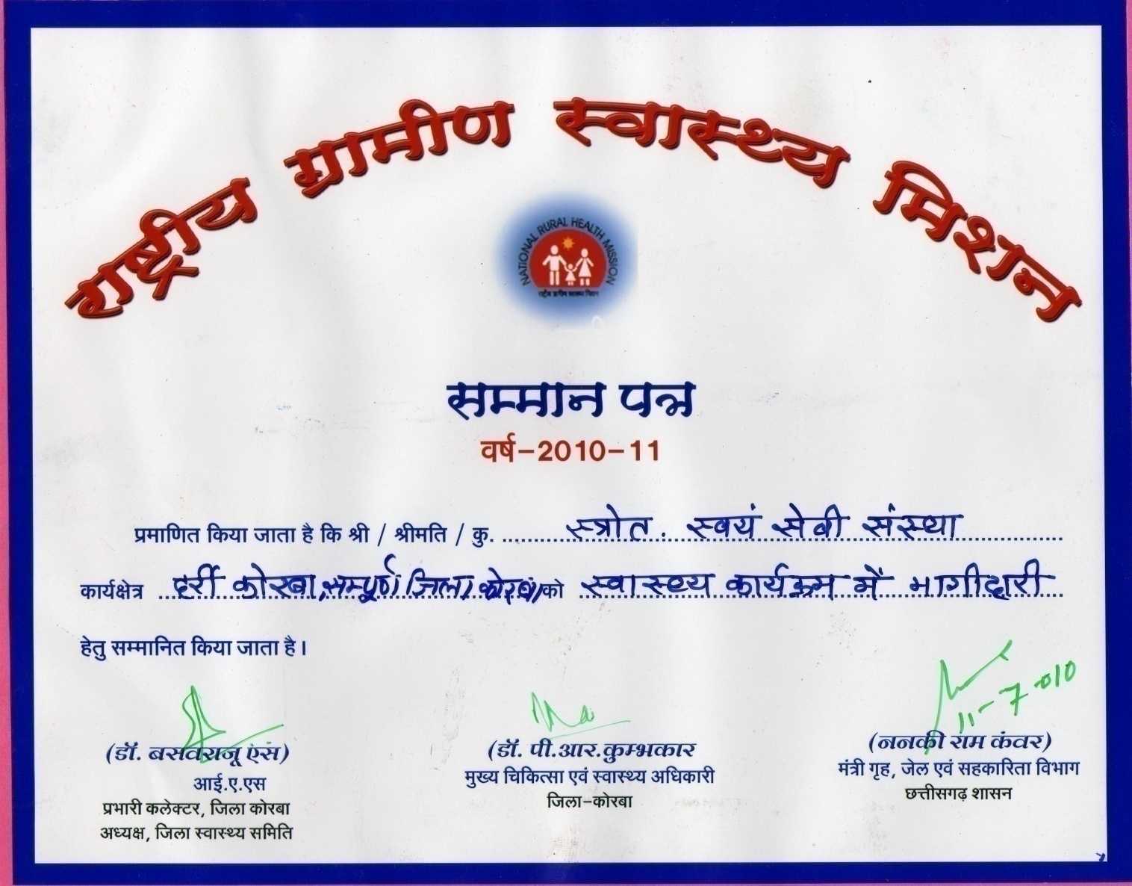
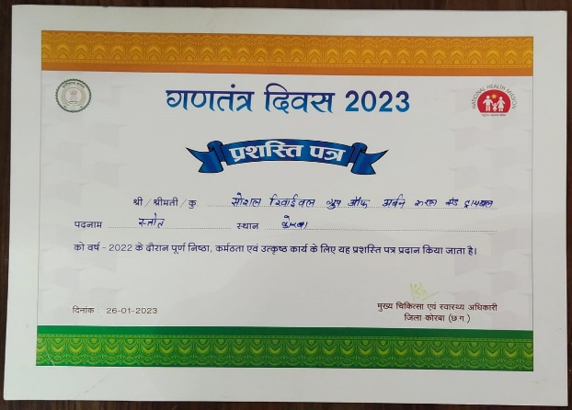
APPRECIATIONS

Slide 16
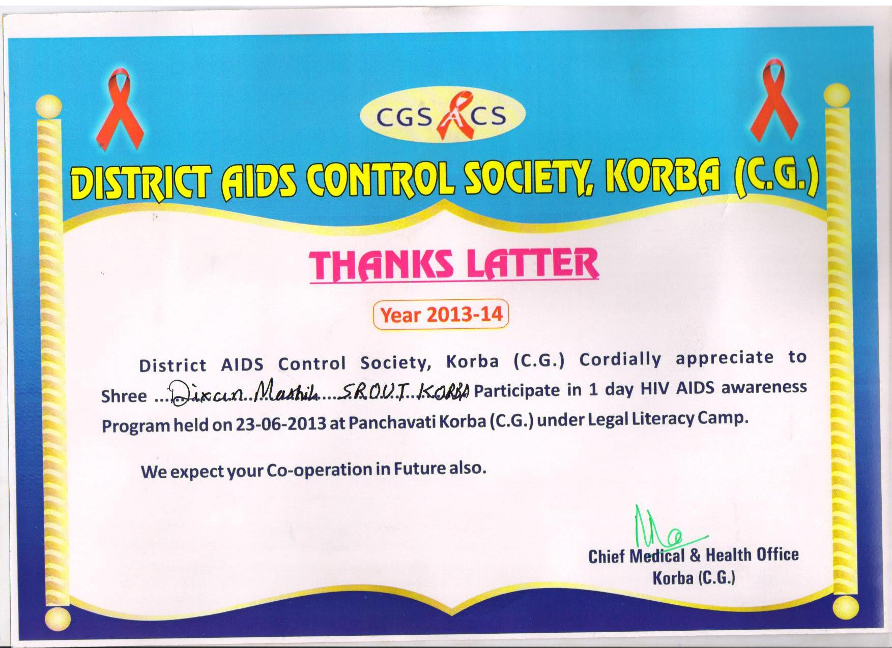
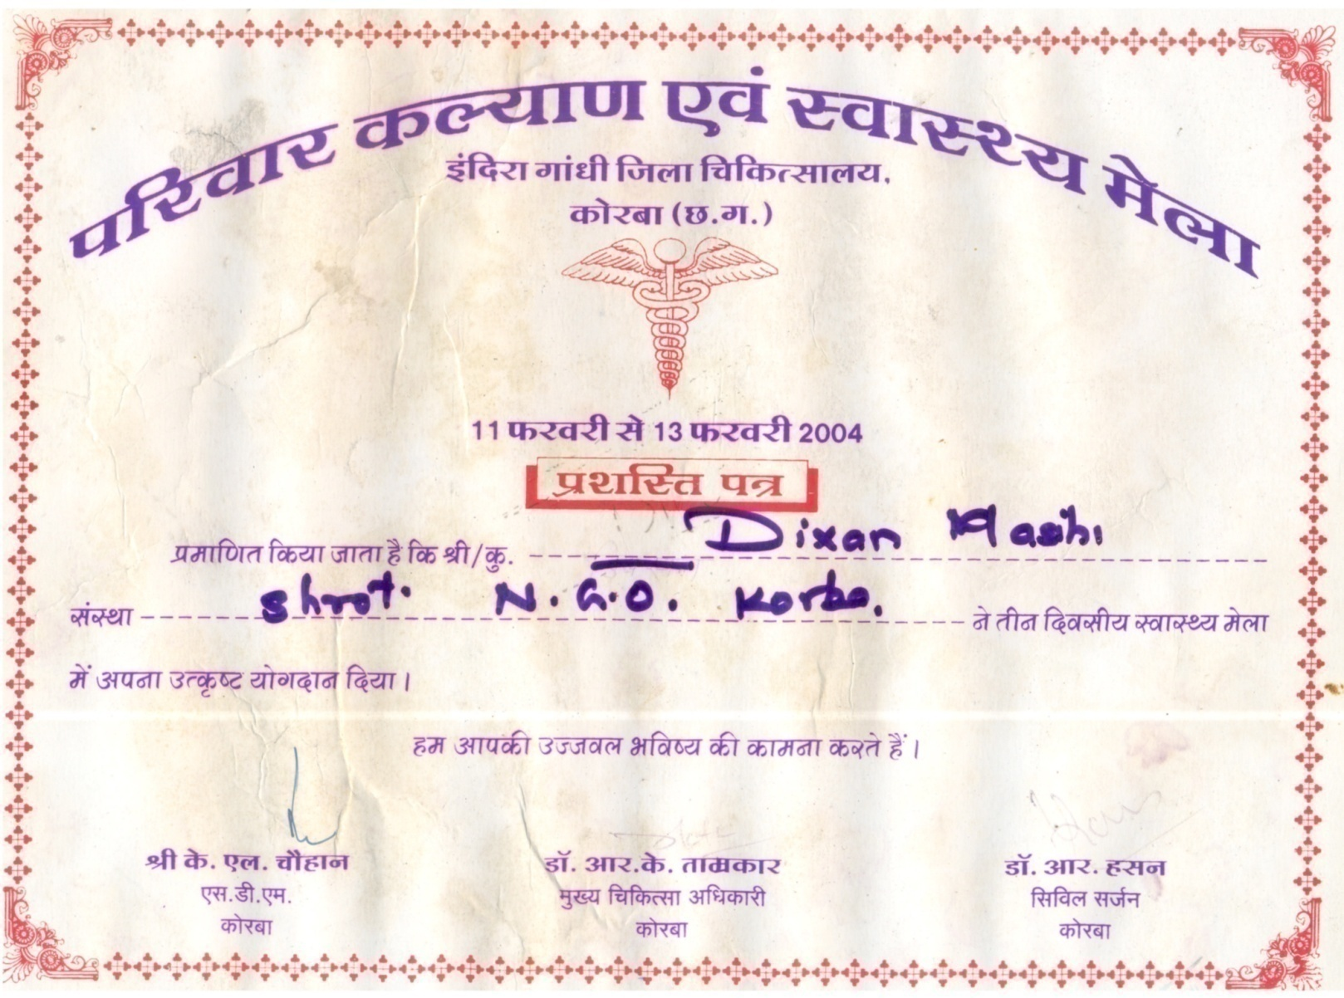

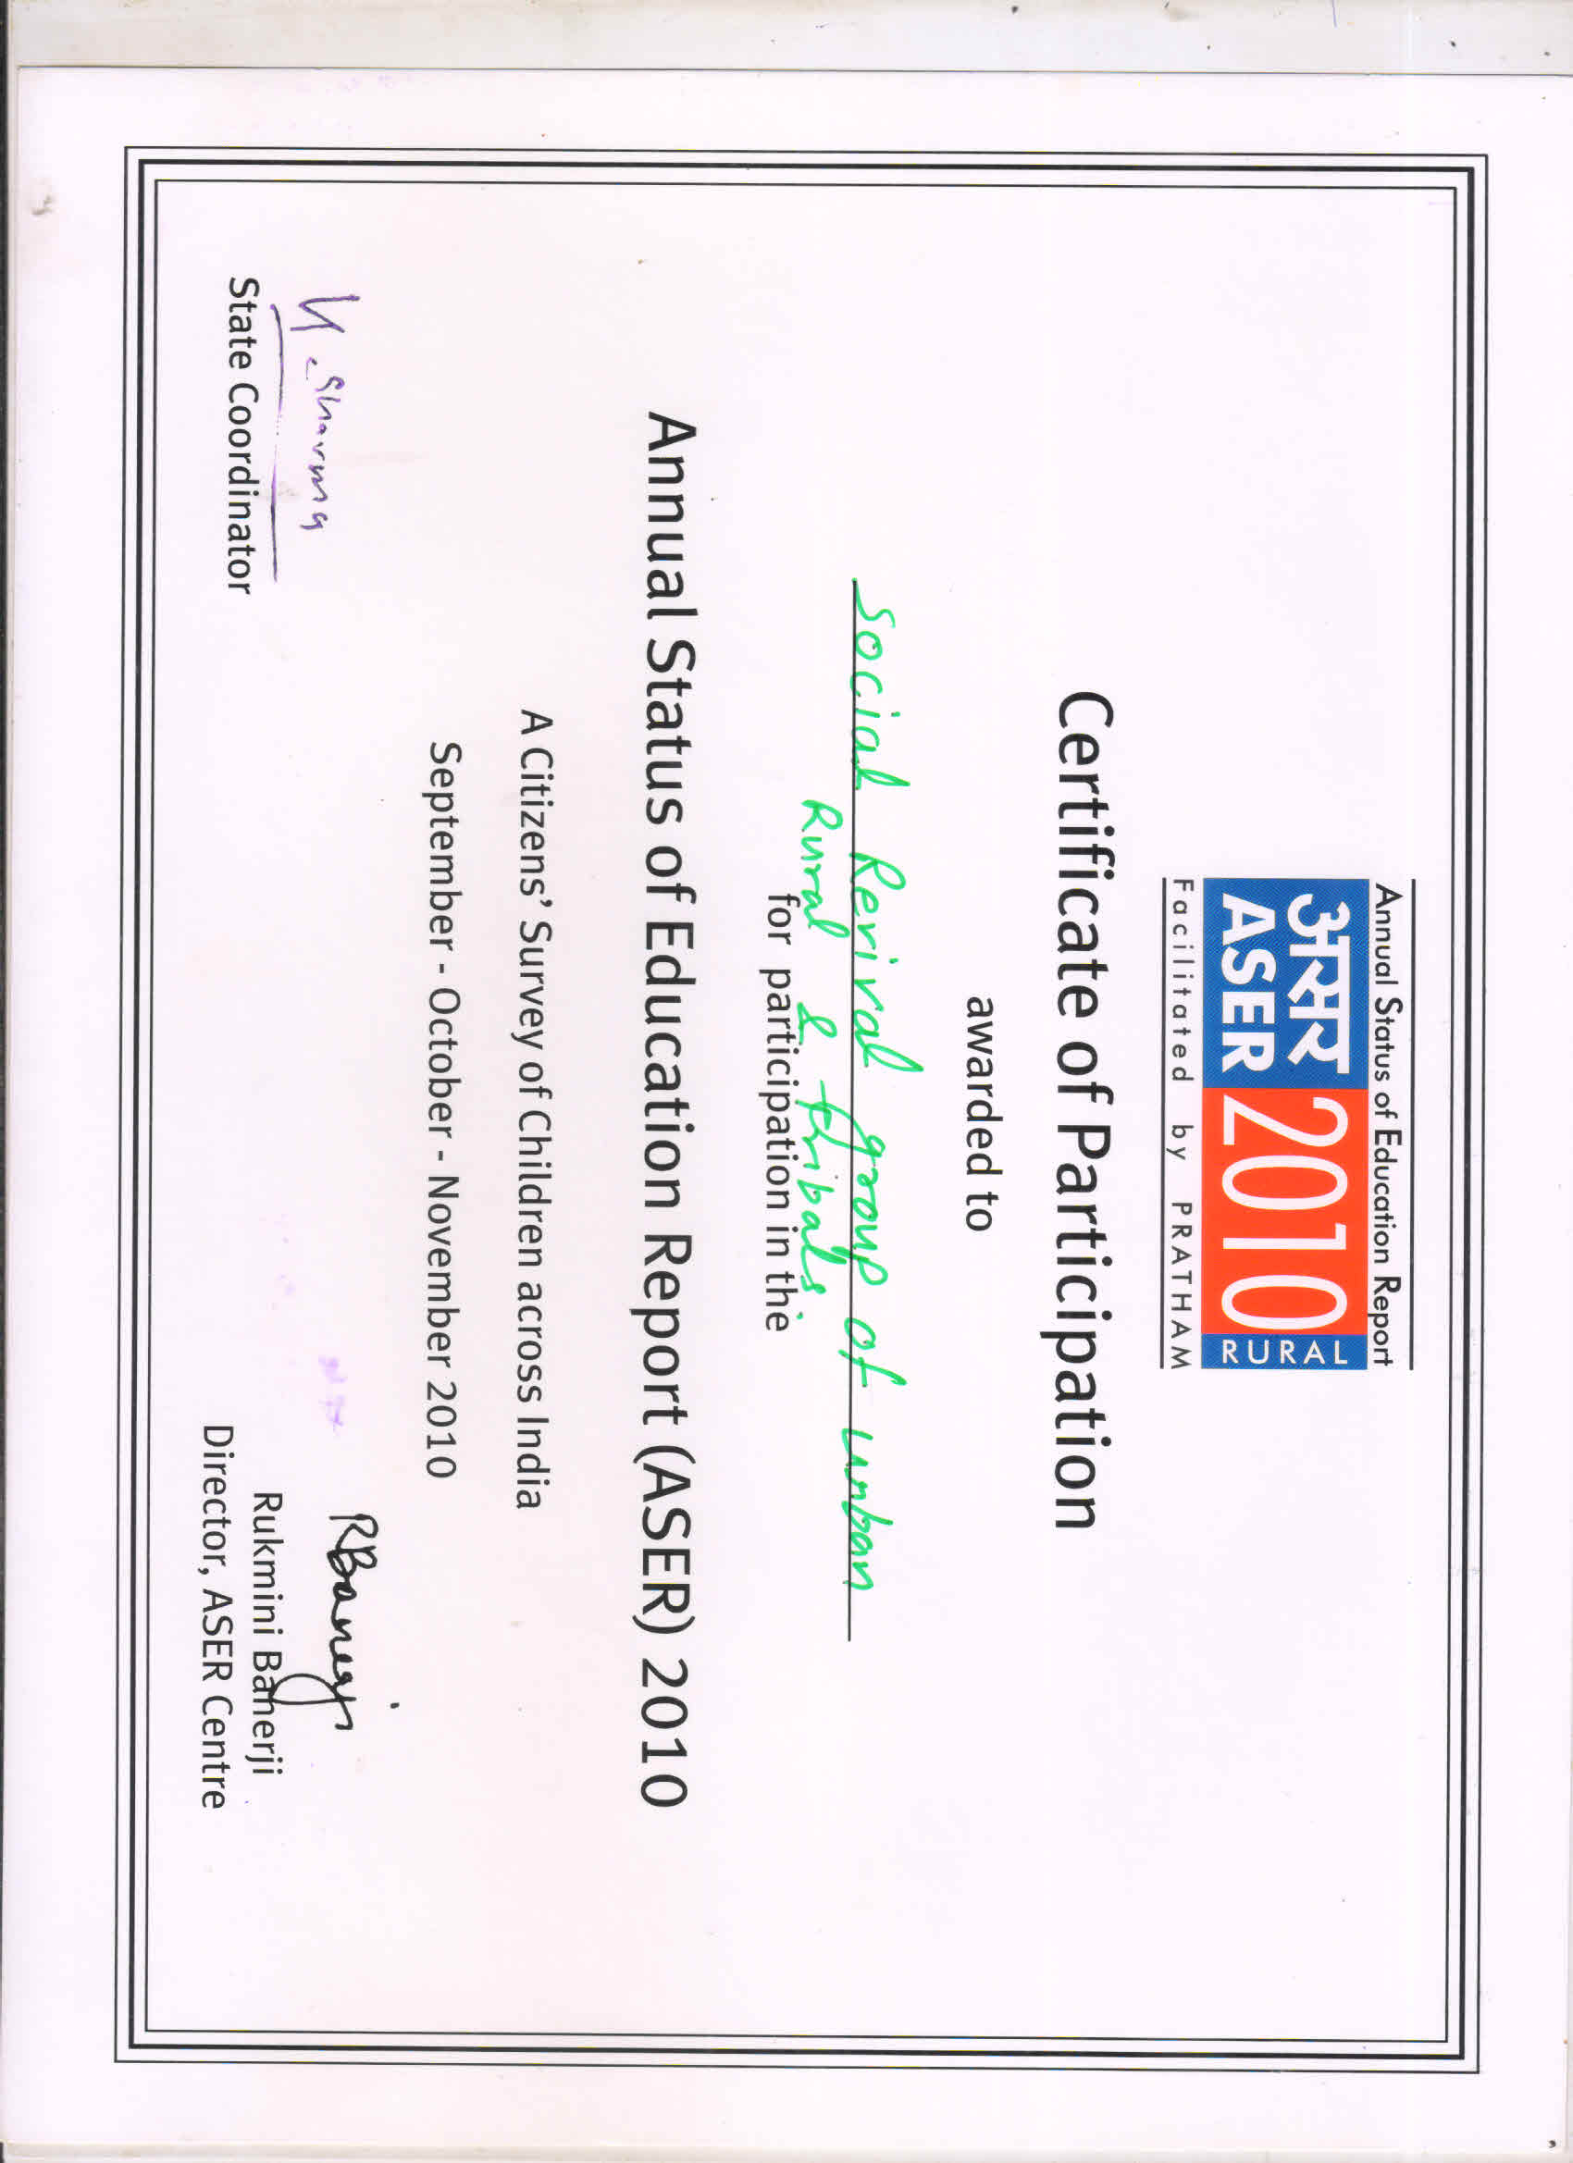
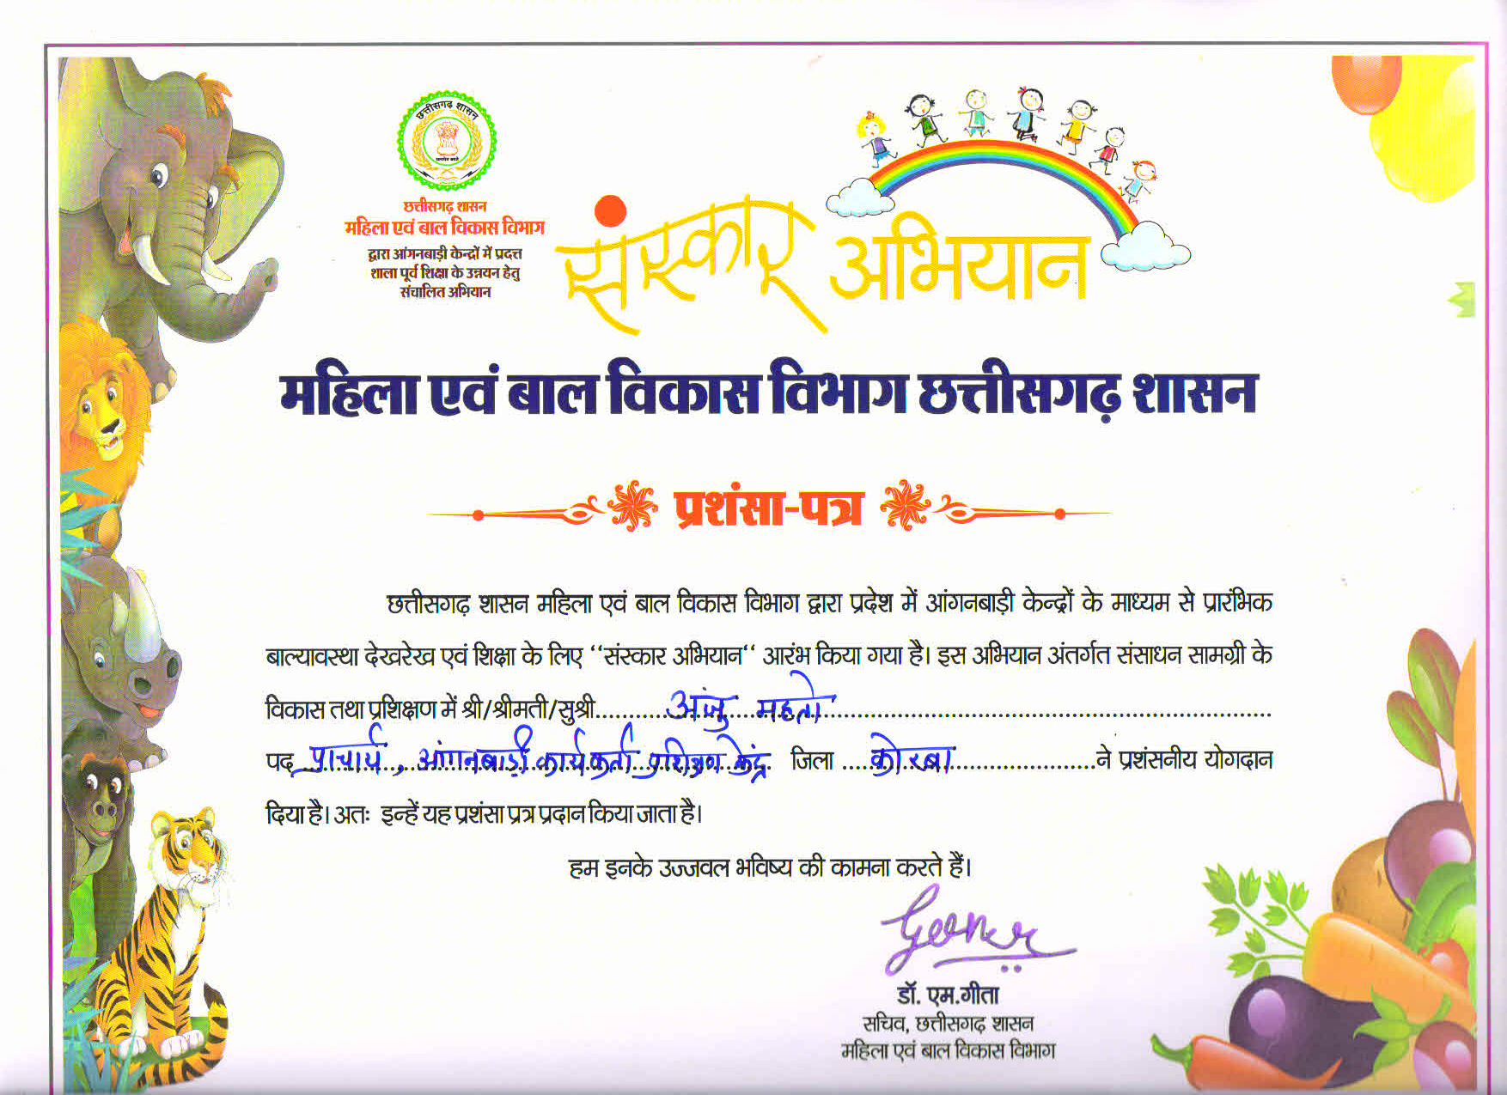
APPRECIATIONS

Slide 17
